Slide 1

Covid 19
Predicting The Next Outbreak
Derek Westjohn and Elizabeth Stephan

Slide 2

Why This Topic
World’s deadliest viral pandemic since the Spanish Flu
Some areas seemed to be more devastated by the outbreak than others
Understand factors that contributed to the unequal devastation
Questions to Answer
Is there an underlying correlation between the areas that with hit harder with Covid.
Can we use this information to predict future outbreaks and subsequently can the information be used to prevent future outbreaks

Slide 3



Data Sources
NYT - county level Covid19 case and fatality data (github)
USDA Economic Research SErvice
Unemployment and median household income for US, States and Counties 2000-20
Education attainment for US, States, Counties 1970-2019
Population estimates for the US, States and Counties 2010-2020

Slide 4
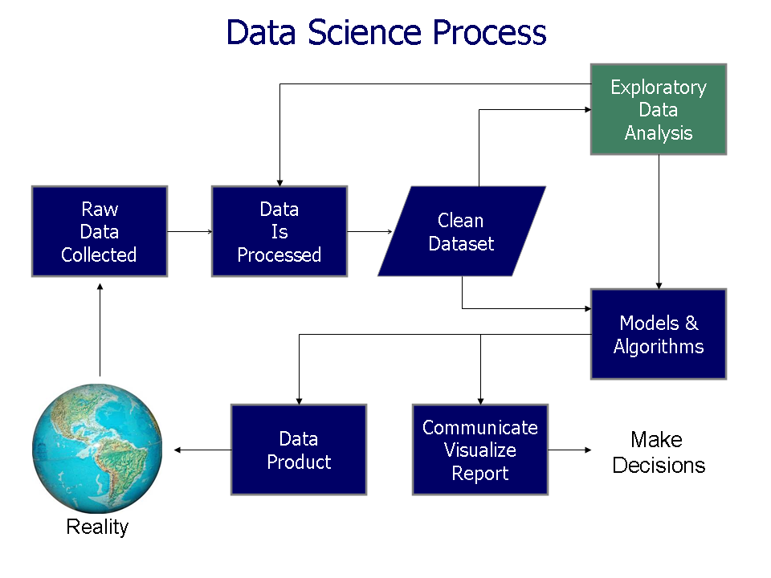

Slide 5
Data Exploration and Analysis
Raw data was taken from NYT Covid 19 fatality data set and also key socio-economic factors from the USDA.
Raw data was stored in Haroku database and linked to PostgreSQL - where tables were created.
The tables were cleaned, null values were investigated and either were changed to 0 or were dropped.
Dataframes were created from the tables and merged on “FIPS” location code,

Slide 6
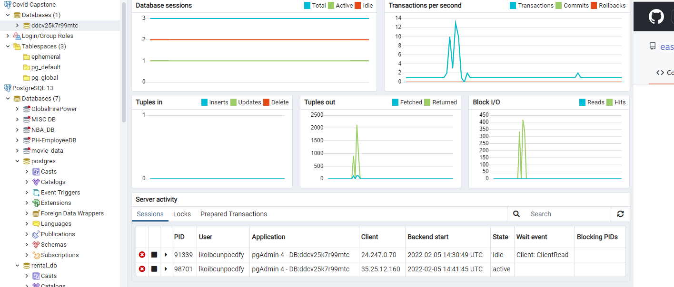
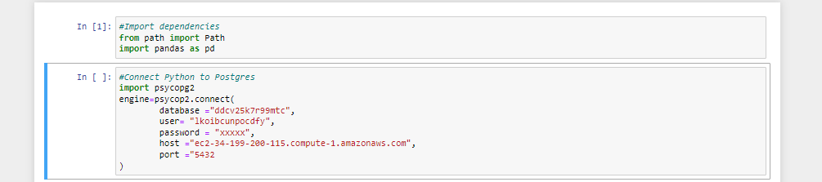

Slide 7
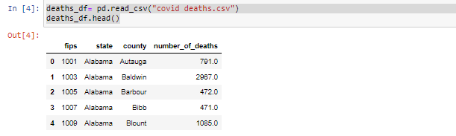
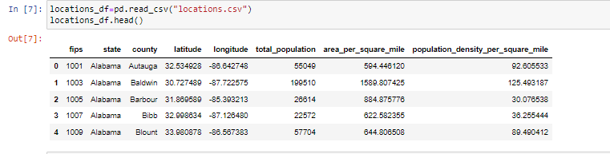
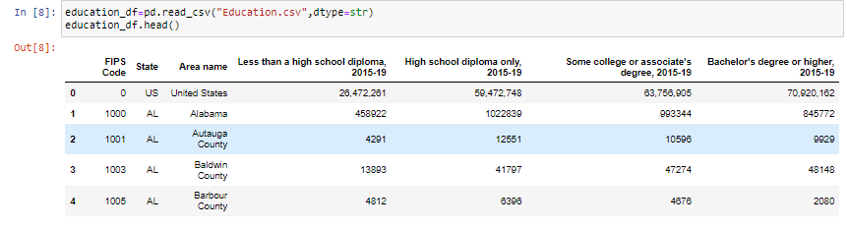
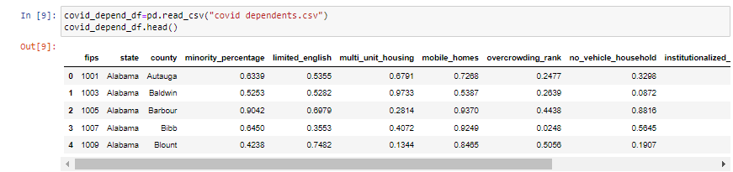

Slide 8
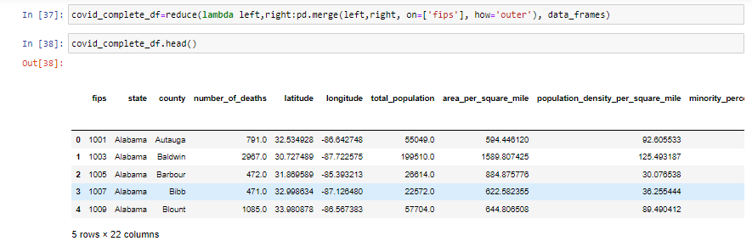
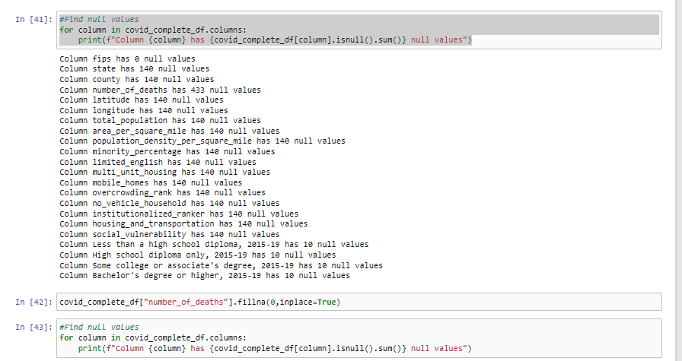

Slide 9
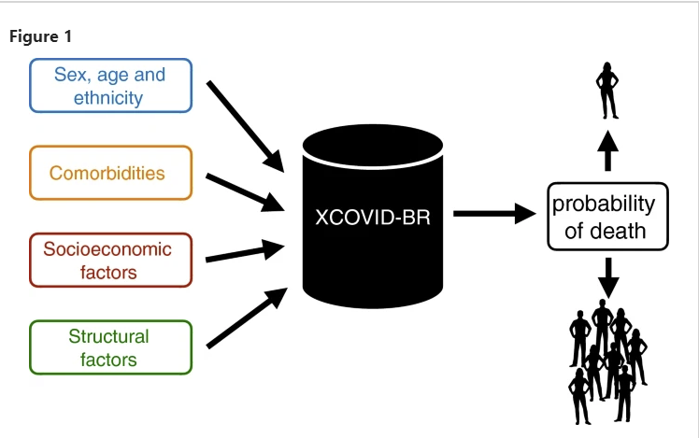

Slide 10
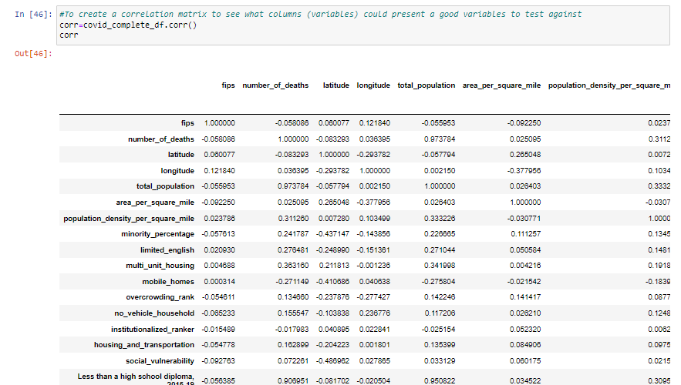

Slide 11
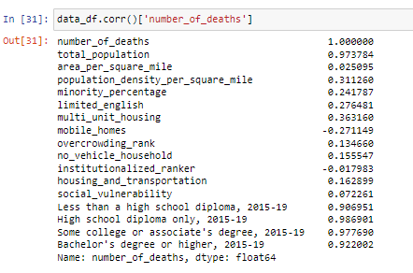

Slide 12
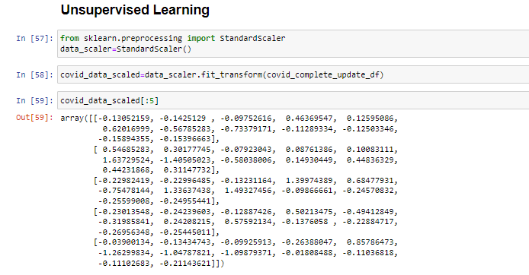
Unsupervised Learning

Slide 13
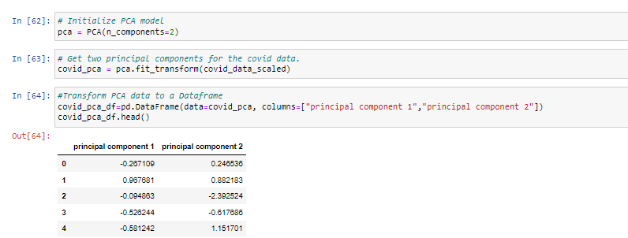


Slide 14
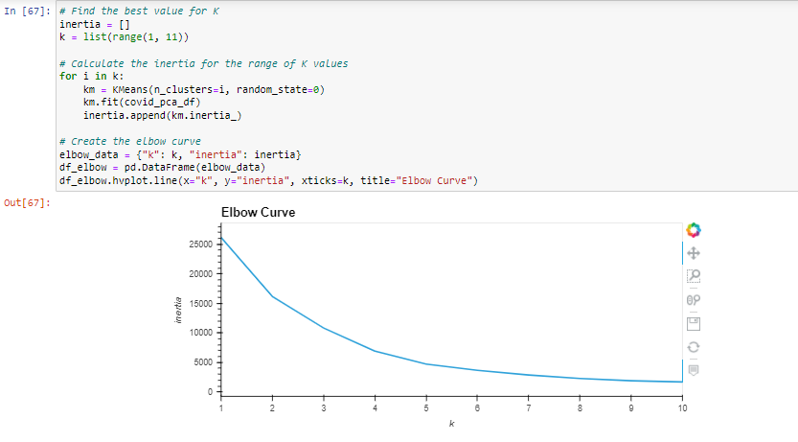

Slide 15
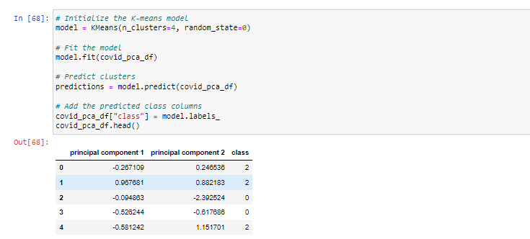

Slide 16
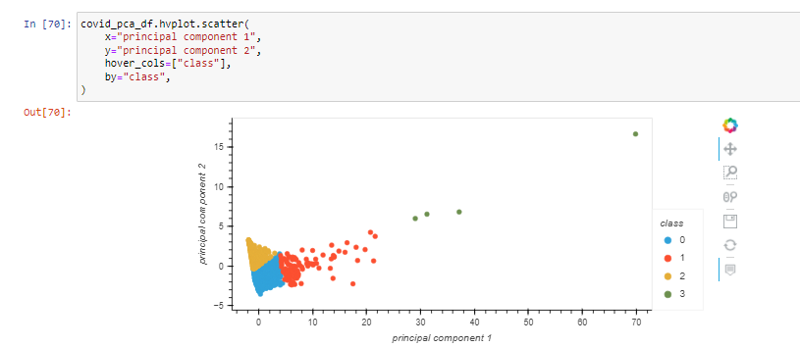

Slide 17
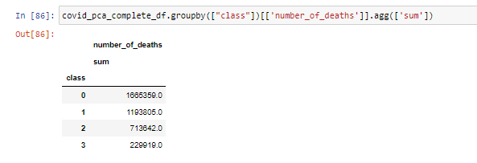
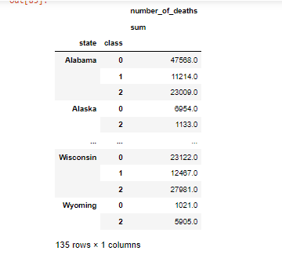

Slide 18
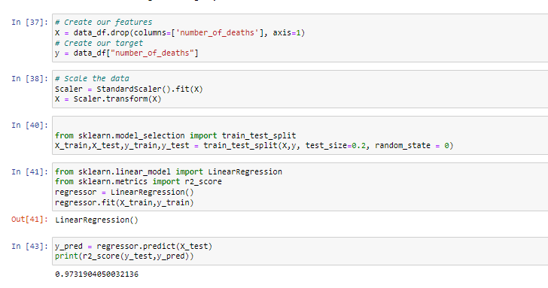

Supervised Learning

Slide 19
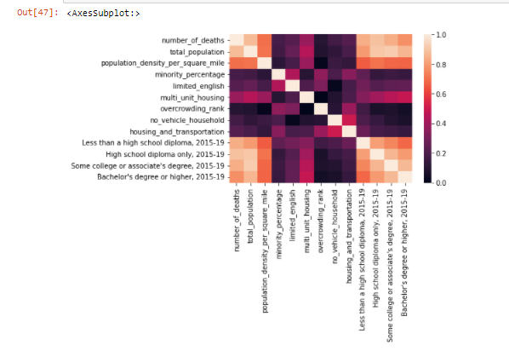

Slide 20
Results
This model confirmed a lot of what is already known about COVID 19 and it’s ultimate fatality
Areas with larger populations are prone to have higher death rates
Areas with larger populations of minorities are more likely to have higher death rates
Populations that have limited english have higher death rates
Multi-unit housing also is more inclined to have higher death rates
Alternatively the level of education (higher education) leads to lower death rates

